Slide 1
Natural Language Processing DTS305TC
Huakang Li
Huakang.li@xjtlu.edu.cn
School of AI and Advanced Computing
Notes:
English Title: Uppercase, Calibri size 60, XJTLU Navy
English Subtitle: Uppercase, Calibri size 36, XJTLU Navy

Slide 2
Lab 1 Introduction
Week 1 Day 1

Slide 3
contents
Create and run a project with pycharm
Find dataset on the internet
Read text data from files

Slide 4
create and run a project with pycharm
1. Start Pycharm
2. Create a project
3. Create you *.py file
4. Implementate source code
5. Run the “Hello World” program
https://www.jetbrains.com/help/pycharm/getting-started.html

Slide 5
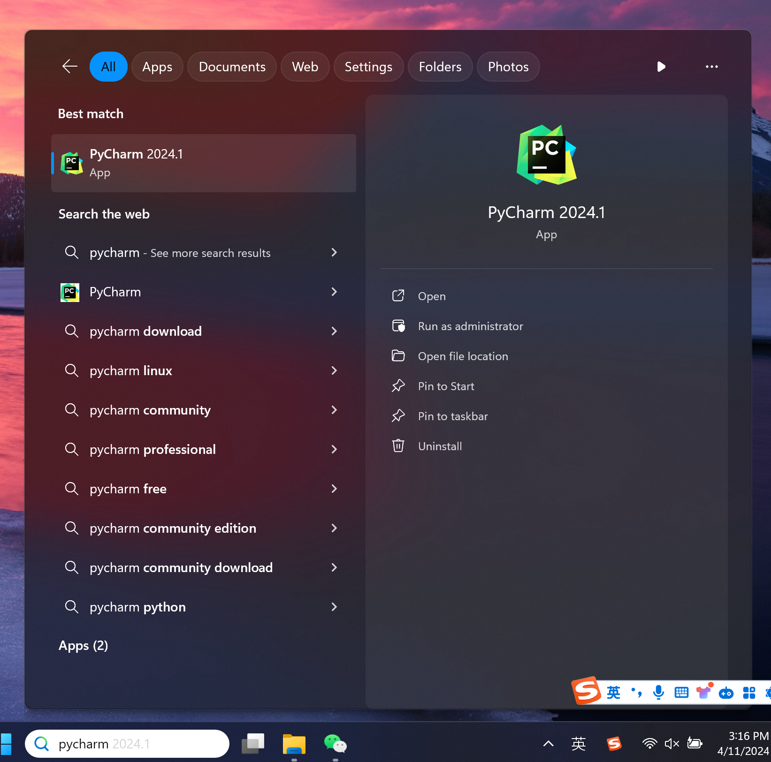
Start Pycharm
1 Type “ PyCharm” in “search box”
2 Click the application
1
PyCharm
2

Slide 6
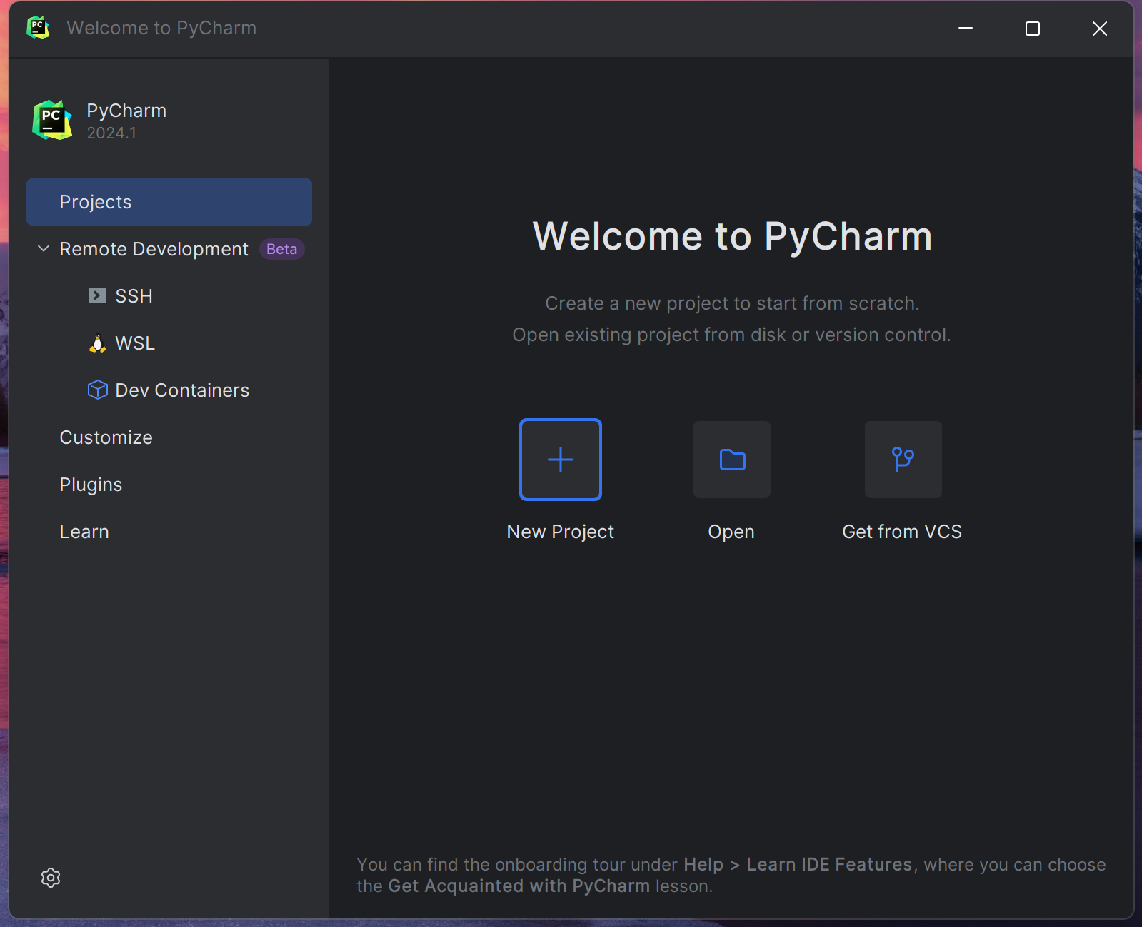
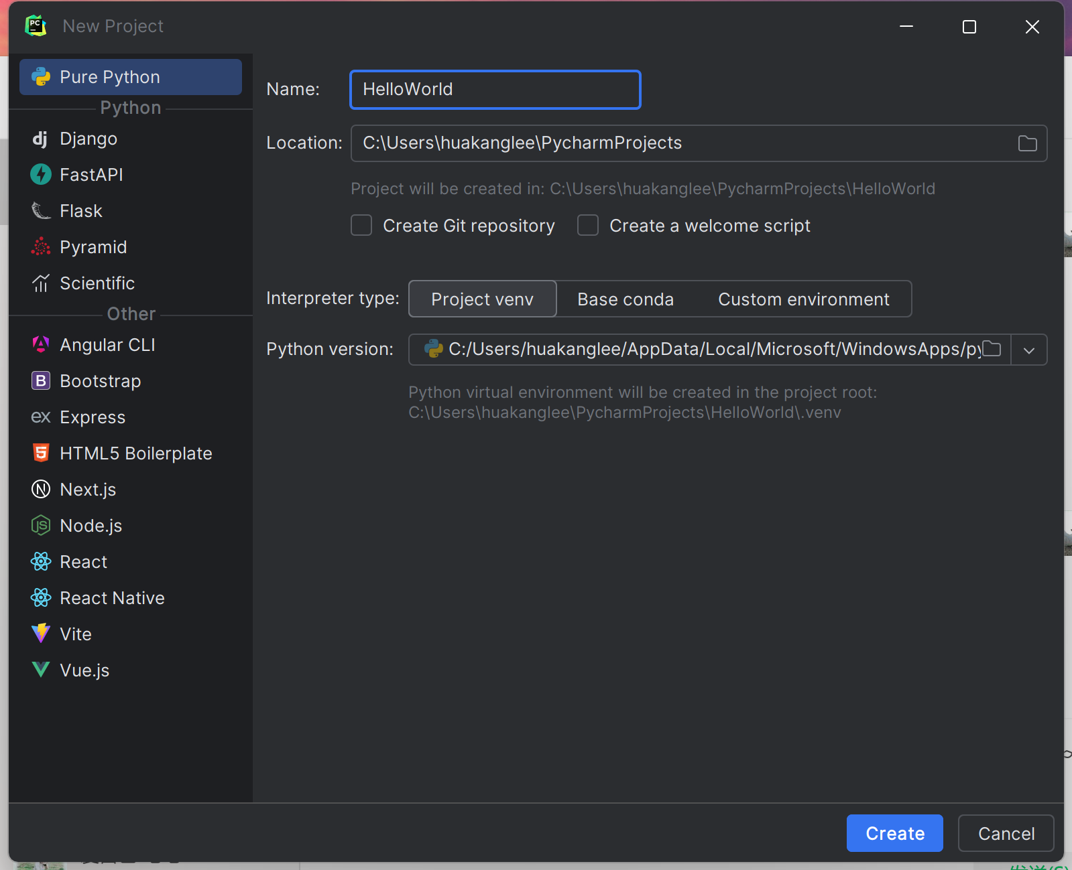
Create a project
1 Click “new project”
2 Define you project name as “HelloWorld”
3 Click the button “Create”
KeyPoint
2
1
3

Slide 7
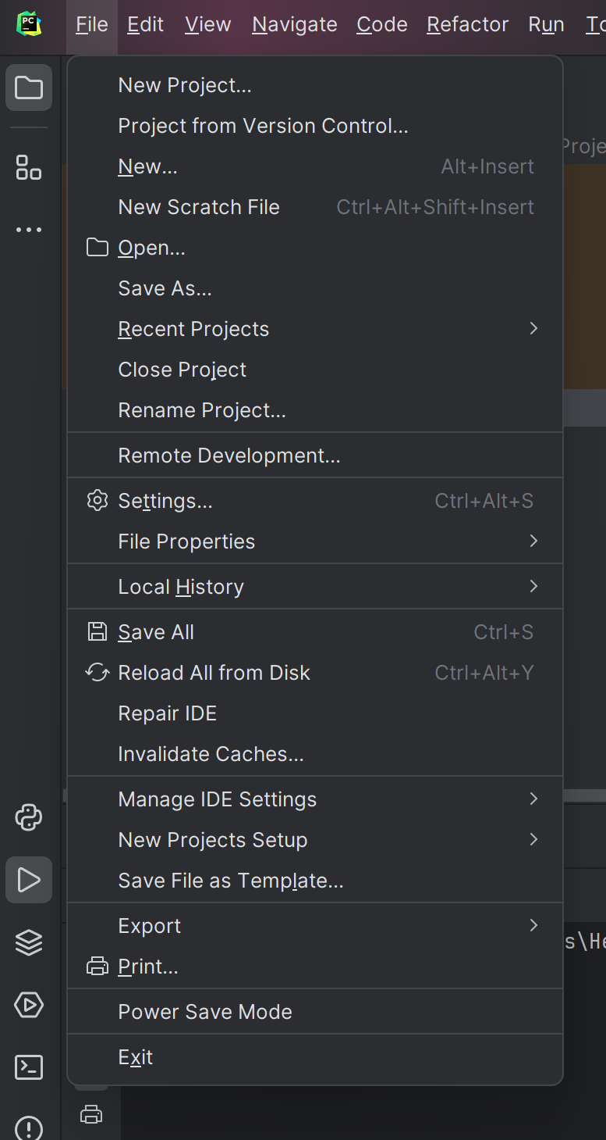
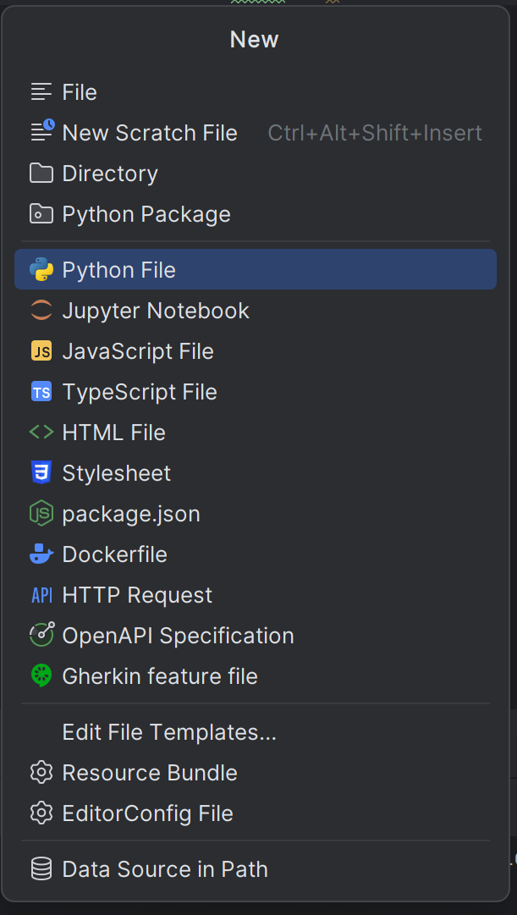
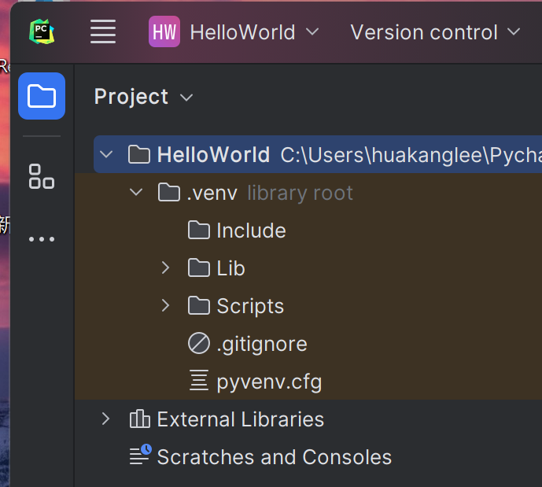
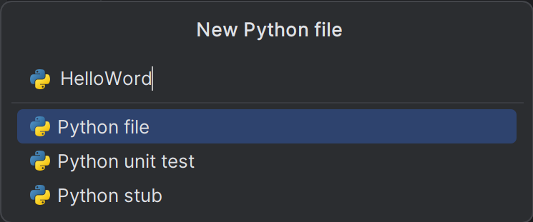
Create you *.py file
1 Click “MainMenu”
2 Click “New”
3 Select “Python File”
4 Name as “HellWorld”
2
1
3
KeyPoint
4

Slide 8
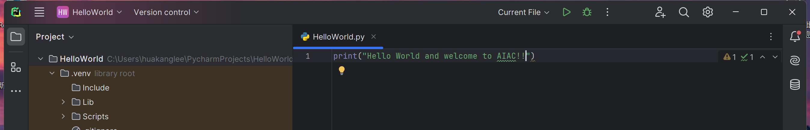
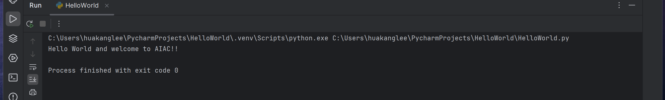
Implement and run the program
Type Print(“Hello World and welcome to AIAC!!”) in HelloWorld.py
Click the run button
Check the system program result

Slide 9
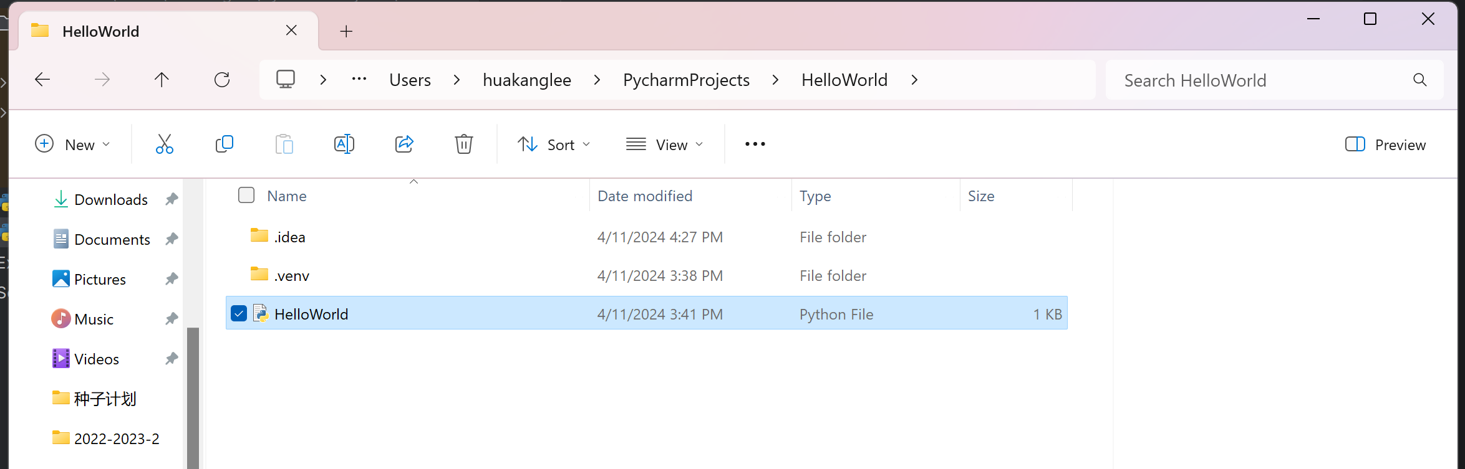
Check local *.py files
Open Local Folder
Find the location of HelloWorld.py

Slide 10
Information from the User
Input refers to any information a user gives to the program. Specifically, the Python command input reads in a line of input typed in by the user. It may also be used to display a message to the user, to prompt for specific input.
The following program reads in the name of the user with the input command. It then prints it out with the print command:
name = input("What is your name? ")
print("Hi there, " + name)
The execution of this program could look like this (input from the user in red):
What is your name? AIAC
Hi there, AIAC
The word name in this program is a variable. In the context of programming, a variable is a location for storing some value, such as a string or a number. This value can be used later, and it can also be changed.

Slide 11
NLP competitions
Input refers to any information a user gives to the program. Specifically, the Python command input reads in a line of input typed in by the user. It may also be used to display a message to the user, to prompt for specific input.
The following program reads in the name of the user with the input command. It then prints it out with the print command:
name = input("What is your name? ")
print("Hi there, " + name)
The execution of this program could look like this (input from the user in red):
What is your name? AIAC
Hi there, AIAC
The word name in this program is a variable. In the context of programming, a variable is a location for storing some value, such as a string or a number. This value can be used later, and it can also be changed.

Slide 12
Github
1. GitHub
2. Hugging Face
3. Common Corpus
4. Academic databases and paper repositories
5. Forums and communities in specific fields

Slide 13
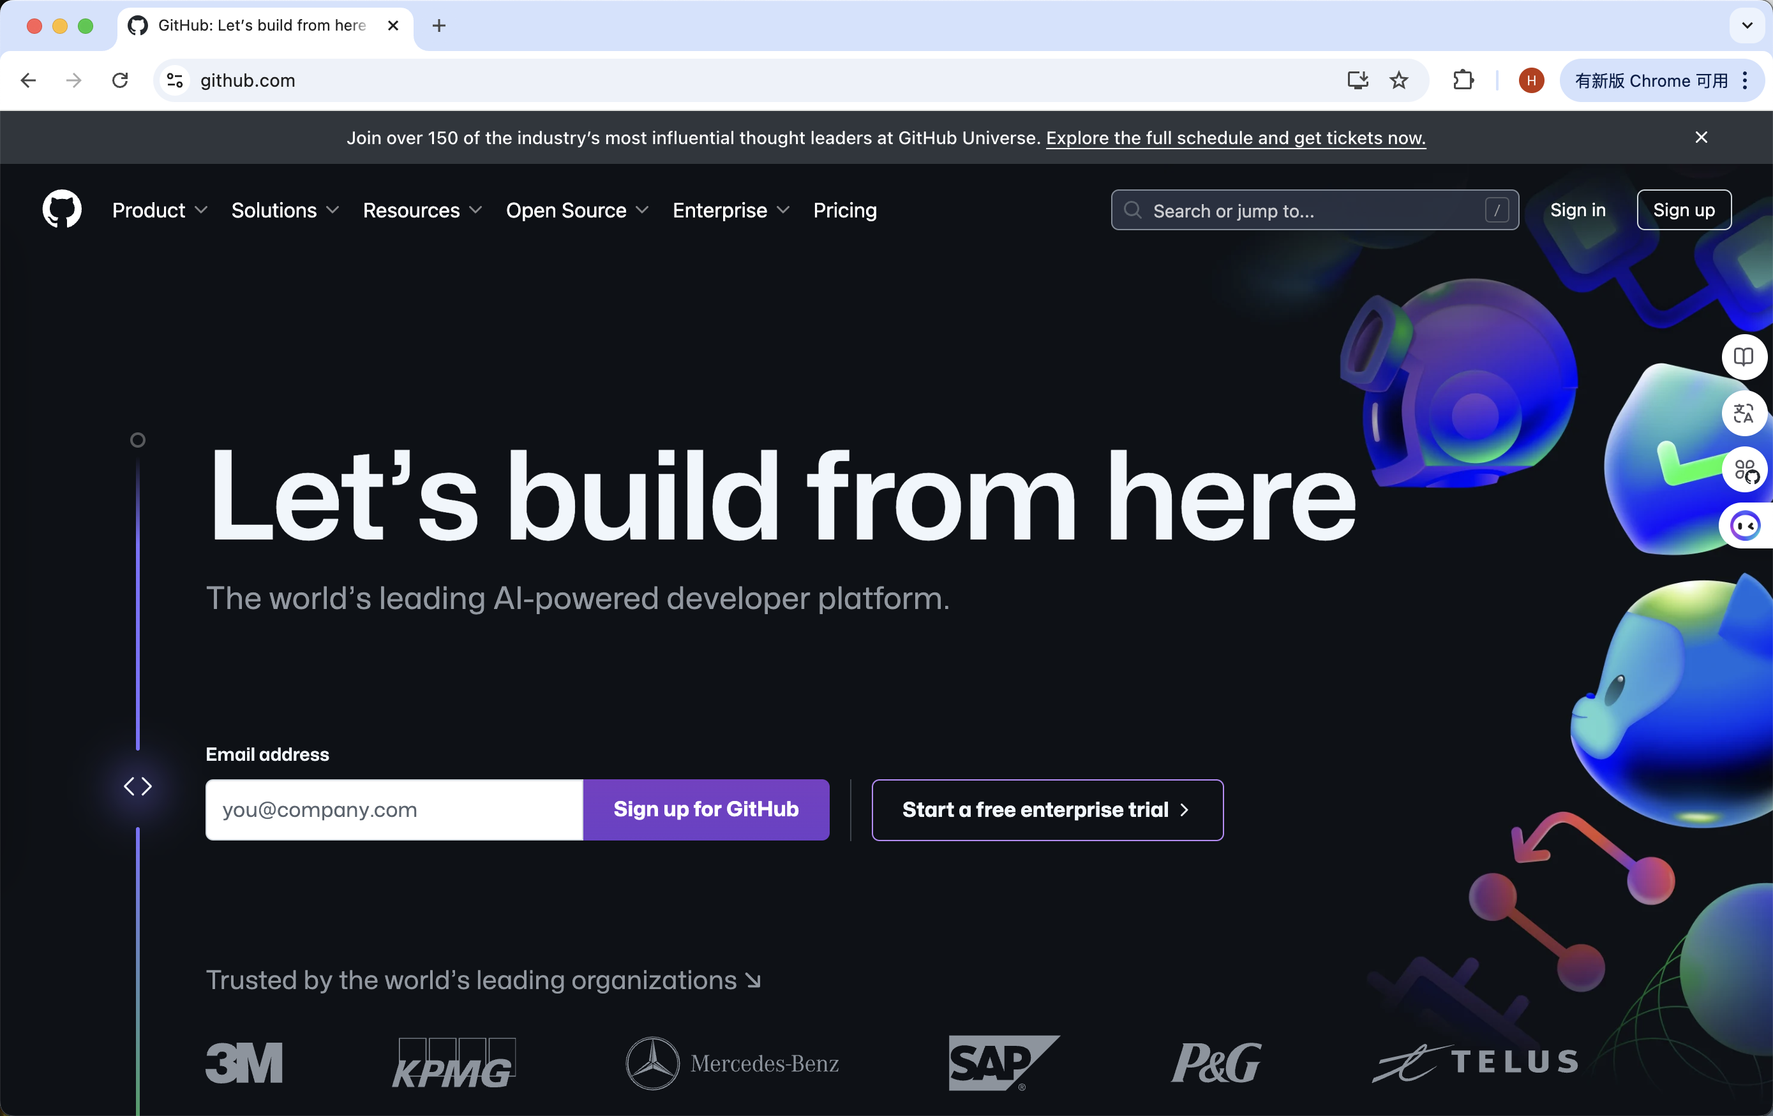
github
GitHub is an open code hosting platform where developers can find a vast collection of natural language processing (NLP) datasets. These datasets are typically contributed by community members and cover everything from simple language models to complex domain specific corpora.
https://github.com

Slide 14
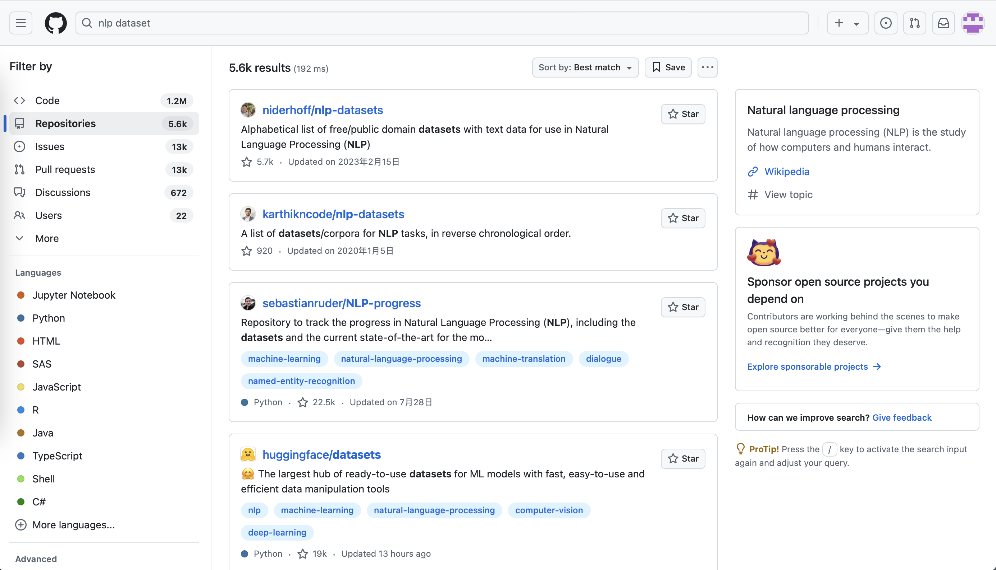
github
Basic search: directly search for "NLP dataset" or more specific "NLP English dataset", "NLP sentiment analysis dataset", etc., and customize search terms according to your specific needs.

Slide 15
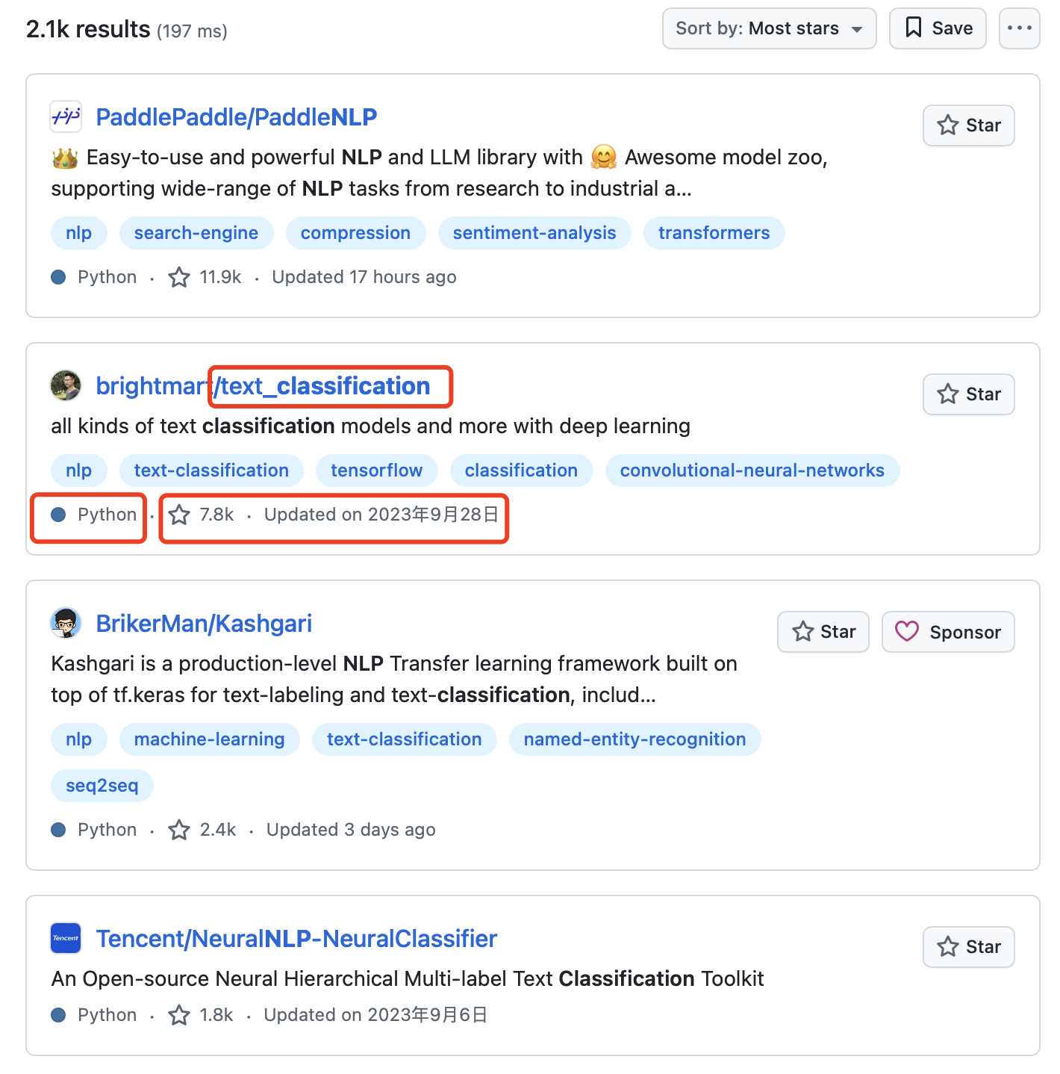
github
When selecting a text training dataset on GitHub, it is important to focus on the following three key items:
Star count: reflects the community recognition and popularity of the dataset. A high Star count usually means that the dataset is of high quality, well-documented, and the community is active.
Data size: It directly affects the training effectiveness of the model and should be selected reasonably based on personal computing resources and time constraints. A larger dataset can provide more training samples, but it may also result in higher processing costs.
Update/Release Time: Reflects the timeliness and maintenance status of the dataset. Recently updated or released datasets may contain the latest language phenomena and trends, which are particularly important for training models that adapt to the current environment.

Slide 16
github
Using the description of the code repository: GitHub allows developers to add keywords or short sentences in the repository description, which you can use to search for repositories containing specific keywords. Try searching for 'NLP dataset' in: description.
Specific file formats: If you know the specific format of the dataset (such as CSV, JSON, TXT, etc.), you can add these formats as filtering criteria in the search, such as "NLP dataset" CSV.
Advanced Search: GitHub's advanced search feature allows you to more finely control search results, including the creation time of the repository, the number of stars, whether specific files are included, and more. You can use these features by accessing the GitHub advanced search page.

Slide 17
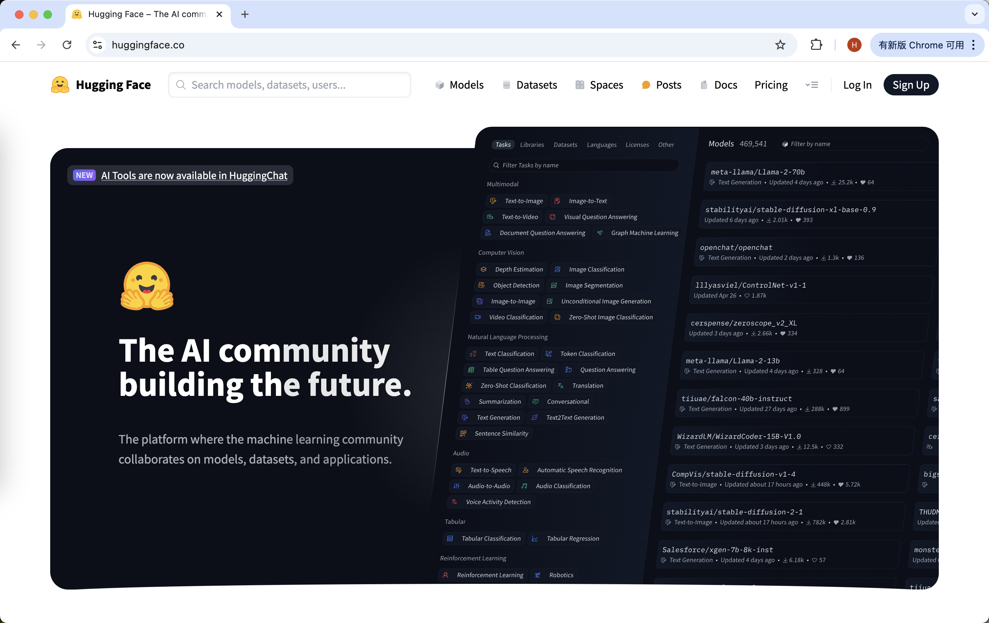
Hugging Face
Hugging Face is an open-source platform dedicated to natural language processing and deep learning research, providing a large number of pre trained models and high-quality datasets. These datasets include multiple task types such as text classification, sentiment analysis, and named entity recognition, making them highly suitable for research and development.
https://huggingface.co/

Slide 18
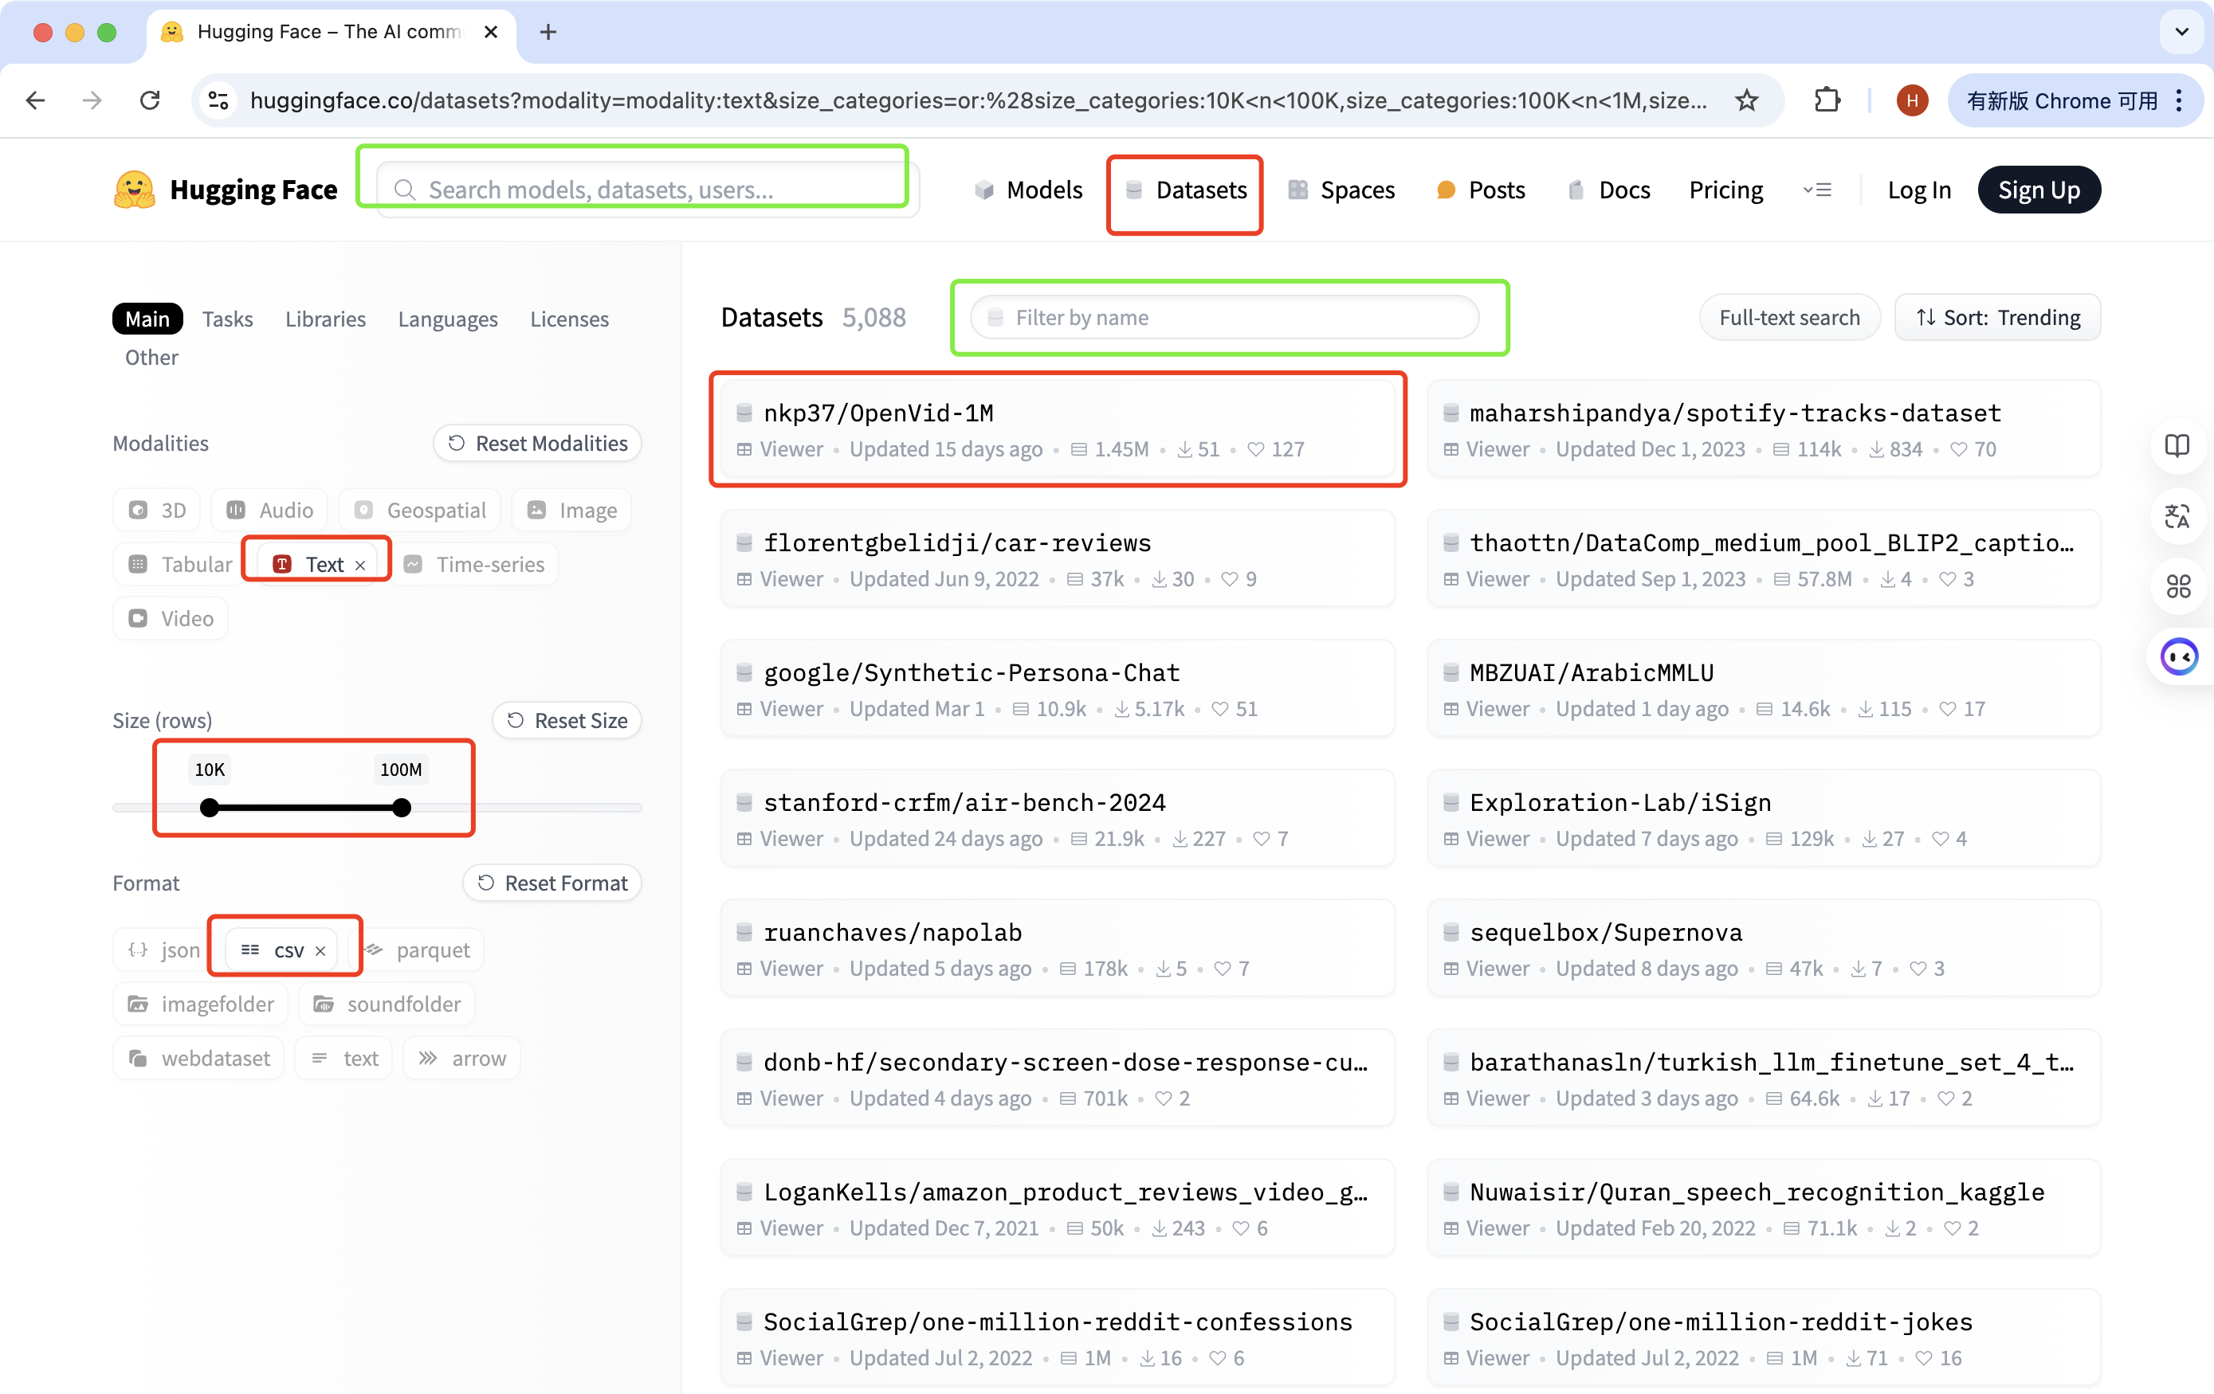
Hugging Face
Use search box:
Browse dataset list:
Using dataset API:
https://huggingface.co/

Slide 19
Hugging Face
Dataset size: Does the size of the dataset meet your needs? Larger datasets typically contain more samples and more comprehensive information, but may also require more computing resources to process.
Data Quality: How is the quality of the dataset? Does it contain noise or incorrect information? Is the annotation of the dataset accurate?
Diversity: Does the dataset cover multiple text types, themes, and language styles? This helps your model better adapt to various practical application scenarios.
Community acceptance: How popular is the dataset? Are there any other researchers or projects using this dataset? A dataset with high community recognition usually means that they have high quality and practical value.
https://huggingface.co/

Slide 20
Common Corpus
Corpus is a public domain dataset jointly created by institutions such as Pleias and Hugging Face, and is currently one of the largest public domain datasets specifically designed for training large language models (LLMs). This dataset gathers 500 billion words from diverse cultural heritage projects worldwide, providing abundant resources for NLP research.

Slide 21
Academic databases and paper repositories
Obtain through academic journals and conference papers
Journal official website: Many academic journals provide relevant datasets as supplementary materials when publishing papers, which can be downloaded directly from the journal official website.
Conference proceedings: In academic conferences, many researchers share their research findings and datasets, which can be obtained by visiting the conference website or viewing the conference proceedings.
Contact the paper author or research institution
Email contact: If the dataset is explicitly mentioned in the paper but no download link is provided, you can try contacting the author of the paper via email to inquire about the method of obtaining the dataset.
Official websites of research institutions: Some research institutions or laboratories may publicly disclose their research results and datasets, which can be accessed and downloaded directly.

Slide 22
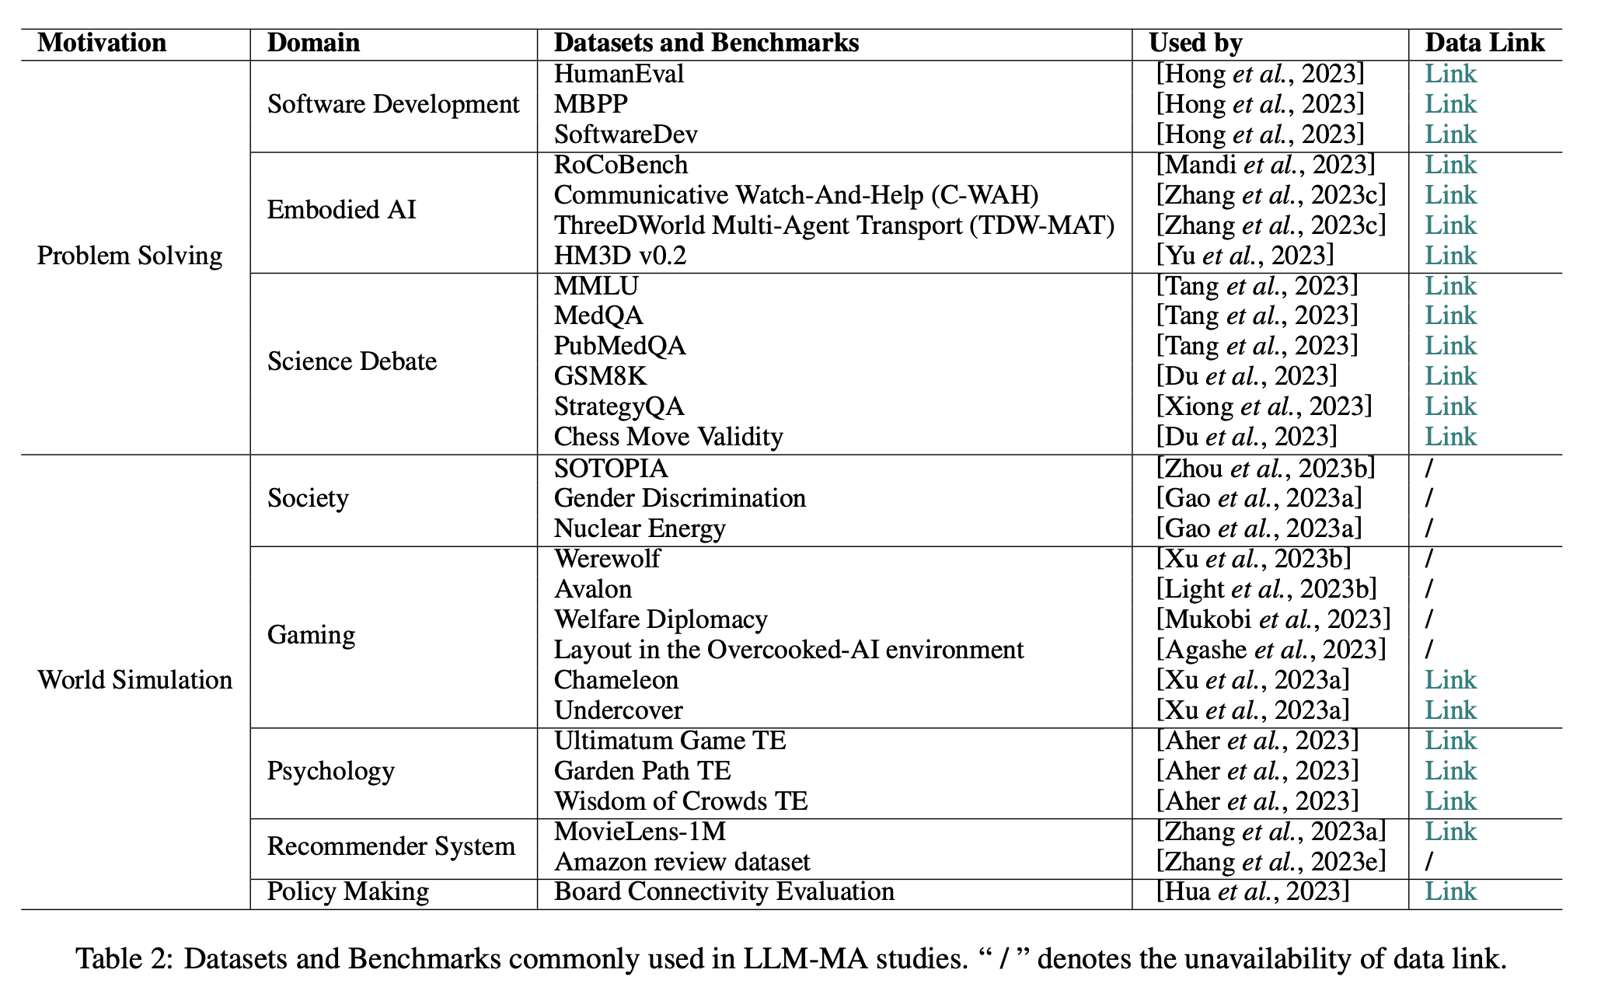
Academic databases and paper repositories
Large Language Model based Multi-Agents: A Survey of Progress and Challenges
https://github.com/pubmedqa/pubmedqa

Slide 23
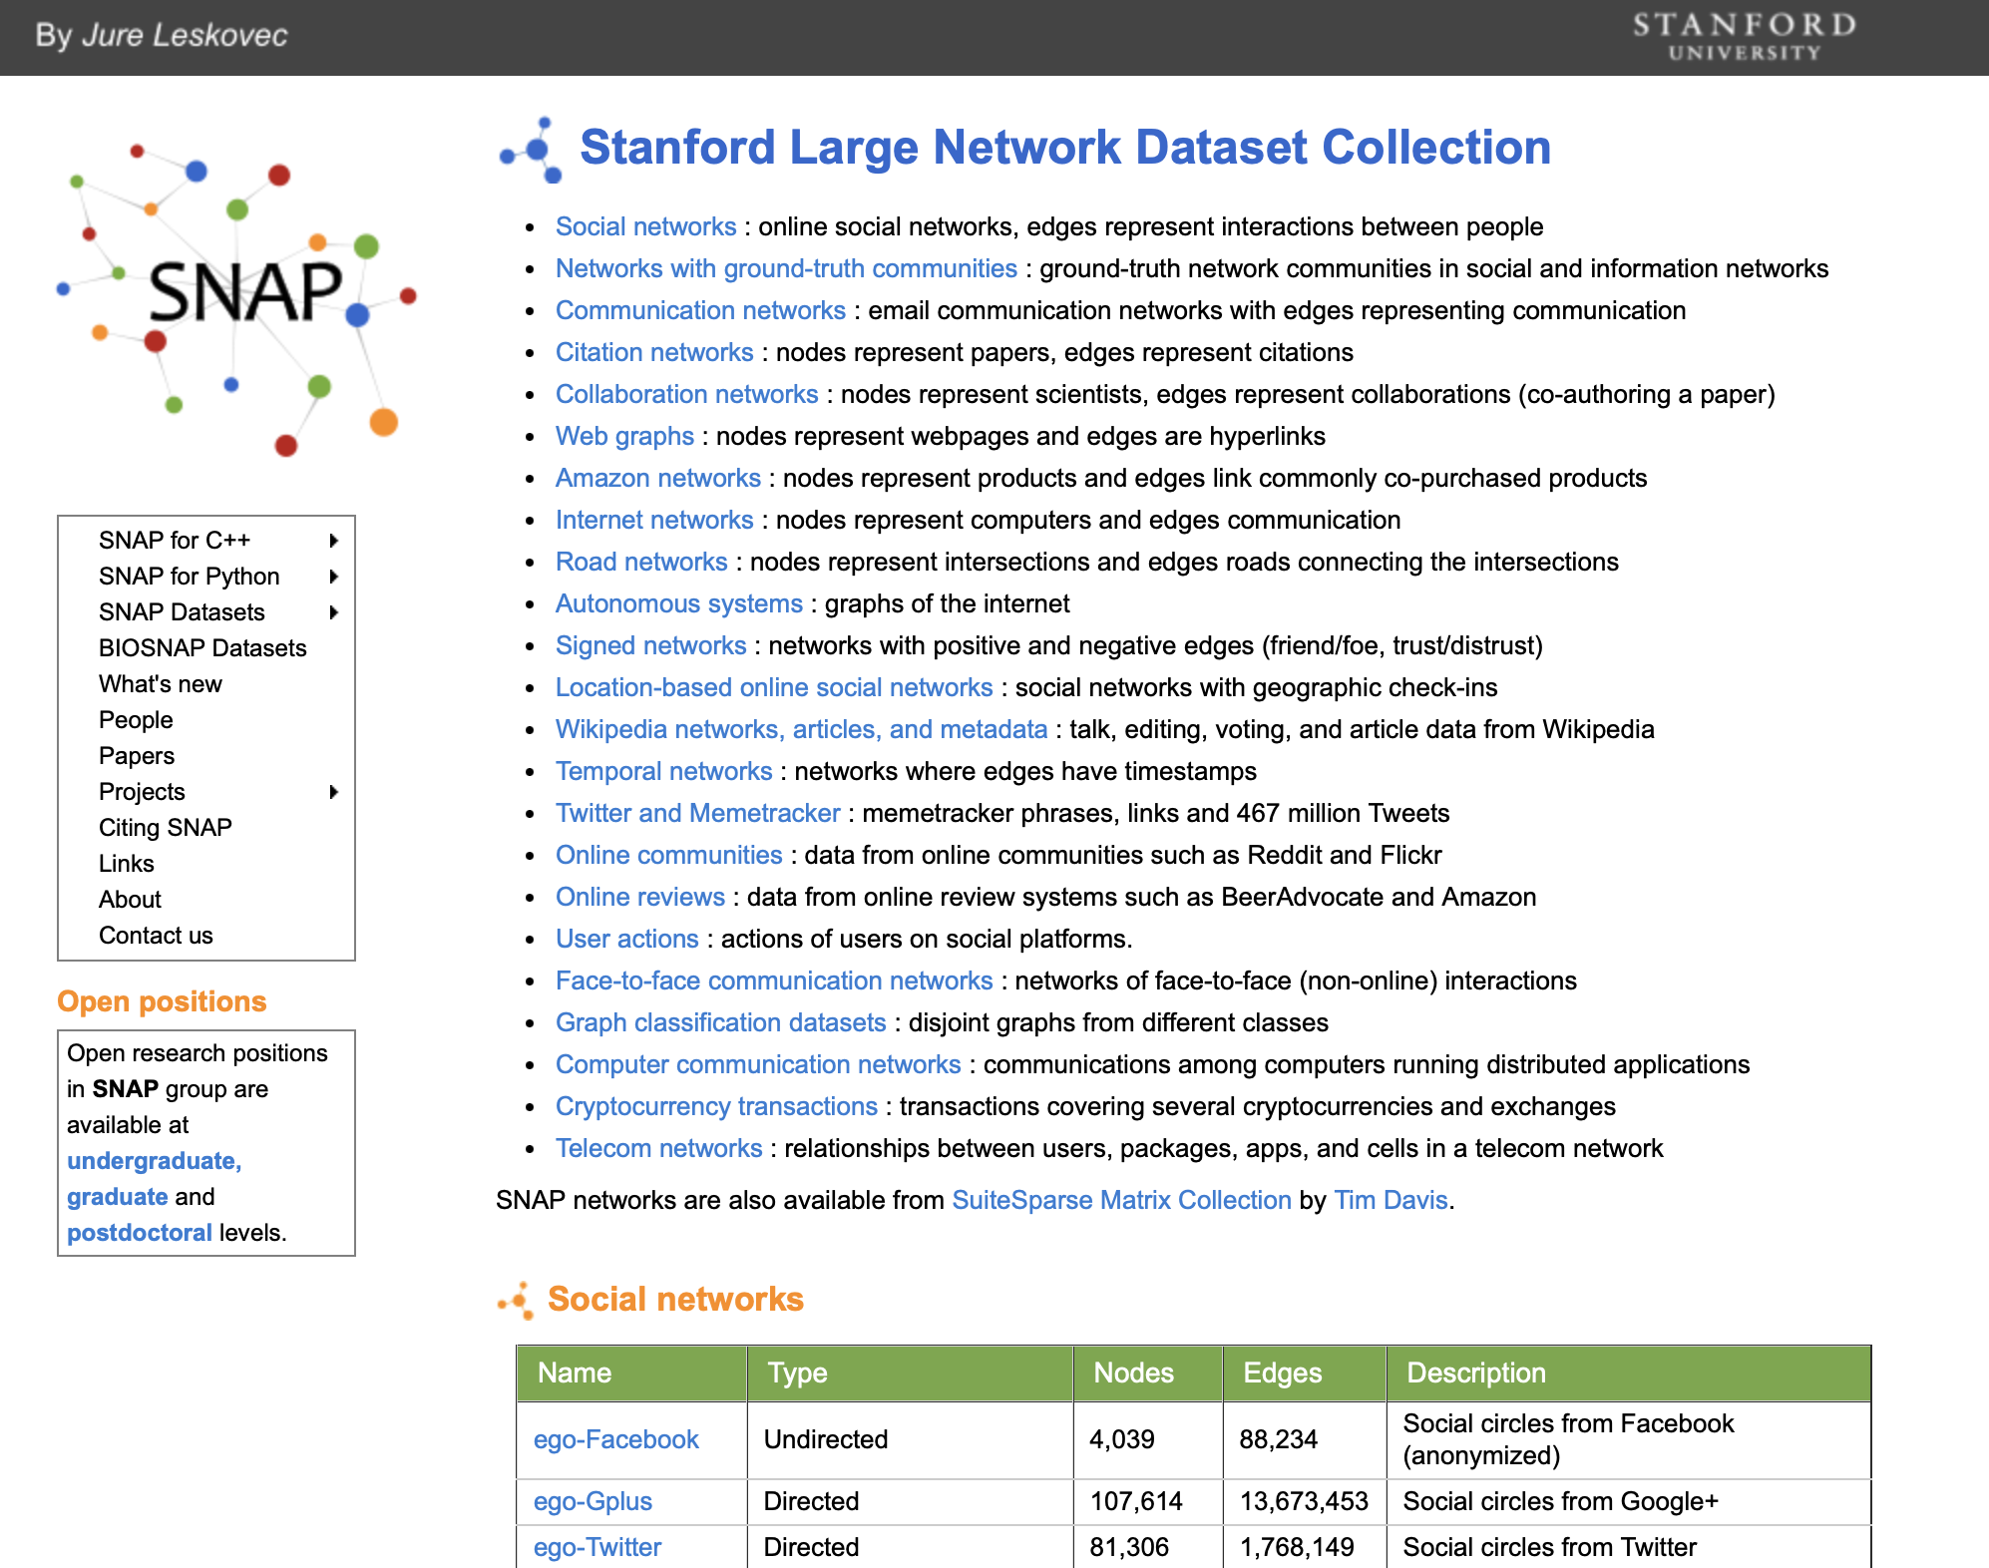
Academic databases and paper repositories
http://snap.stanford.edu/data/

Slide 24
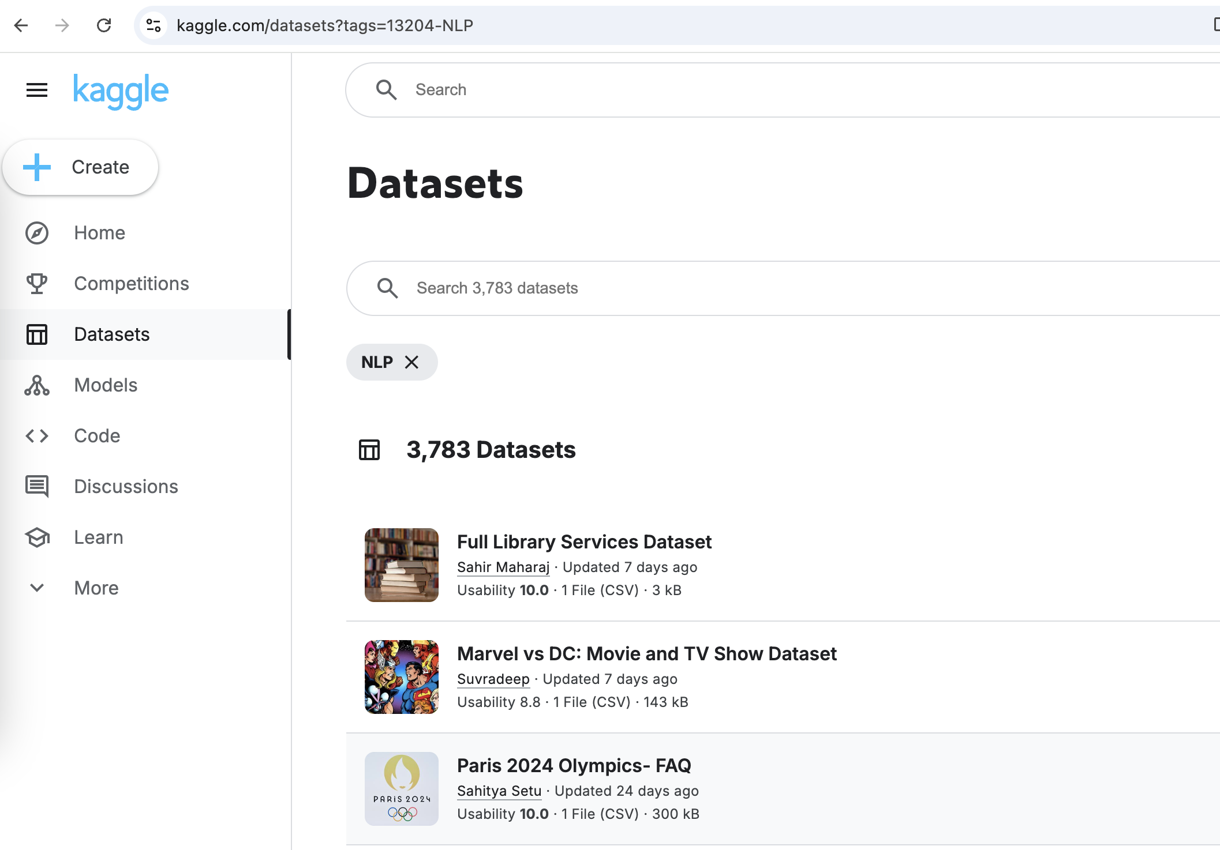
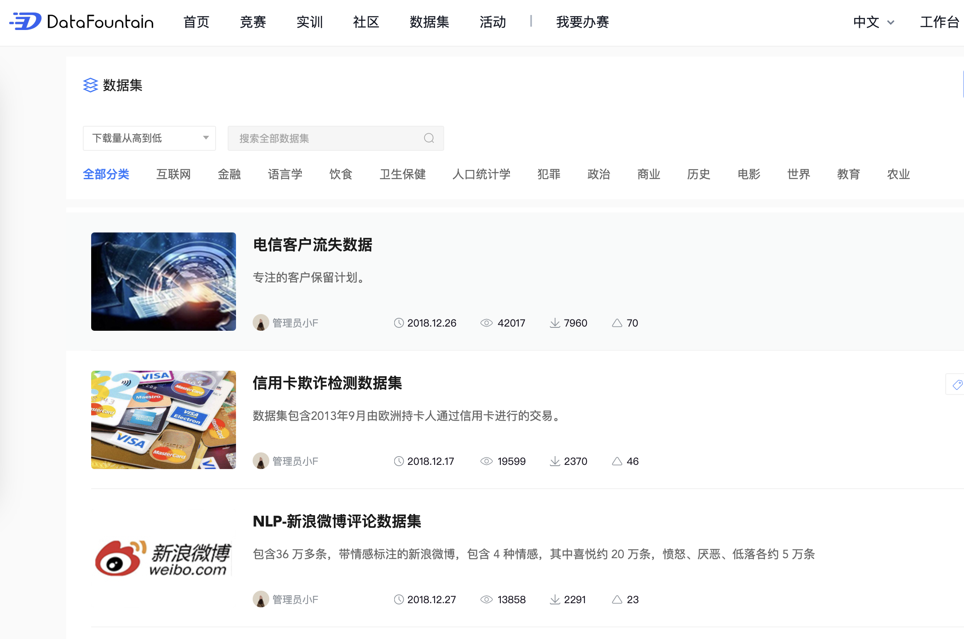
Forums and communities in specific fields
kaggle competition dataset
ccf competition dataset
https://www.kaggle.com/datasets
https://www.datafountain.cn/datasets

Slide 25
Read text data from files
1. Import related data format classes
2. Define the file name as a new variable
3. Use the open function to read file data into a variable
4. Save the required column data to a new variable
5. Print and check if the content of the new variable is correct

Slide 26
Read text data from files
import csv
# CSV file path
file_path = 'business_data.csv'
# List to hold the second column data
second_column_data = []
# Open the CSV file for reading
with open(file_path, mode='r', newline='', encoding='utf-8') as csv_file:
csv_reader = csv.reader(csv_file)
# Skip the header row if present (optional)
# next(csv_reader, None) # Uncomment this line if your CSV has a header
# Iterate over each row in the CSV file
for row in csv_reader:
if len(row) > 1: # Ensure there's at least a second column
second_column_data.append(row[1]) # Append the second column data
# second_column_data now contains all the data from the second column
print(second_column_data)

Slide 27

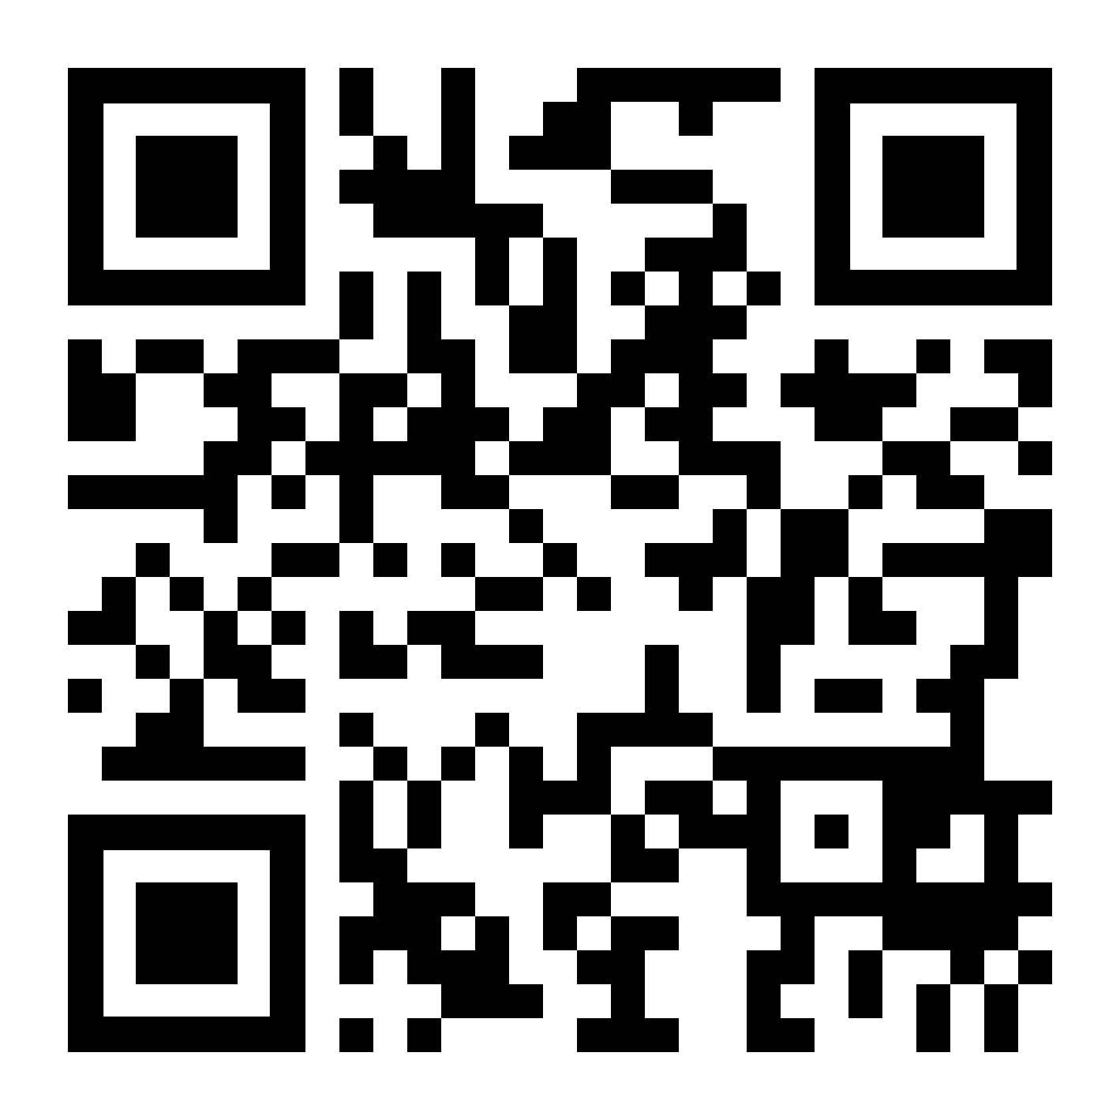

THANK YOU
Visit us
FOLLOW us
www.xjtlu.edu.cn
Notes:
Title: Uppercase, Calibri size 60, XJTLU Navy

